Slide 1
Applying “Questionable File Show & Tell”
to human rights evidence
No Time to Wait 4, Budapest, Dec 2019
Yvonne Ng
Sr. Archivist, WITNESS
yvonne@witness.org

Slide 2
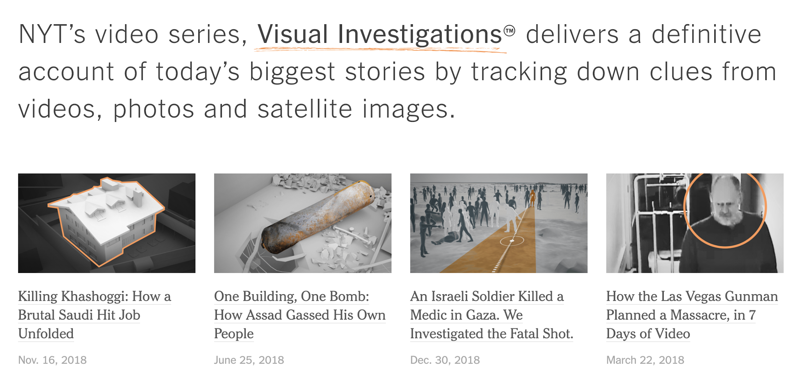
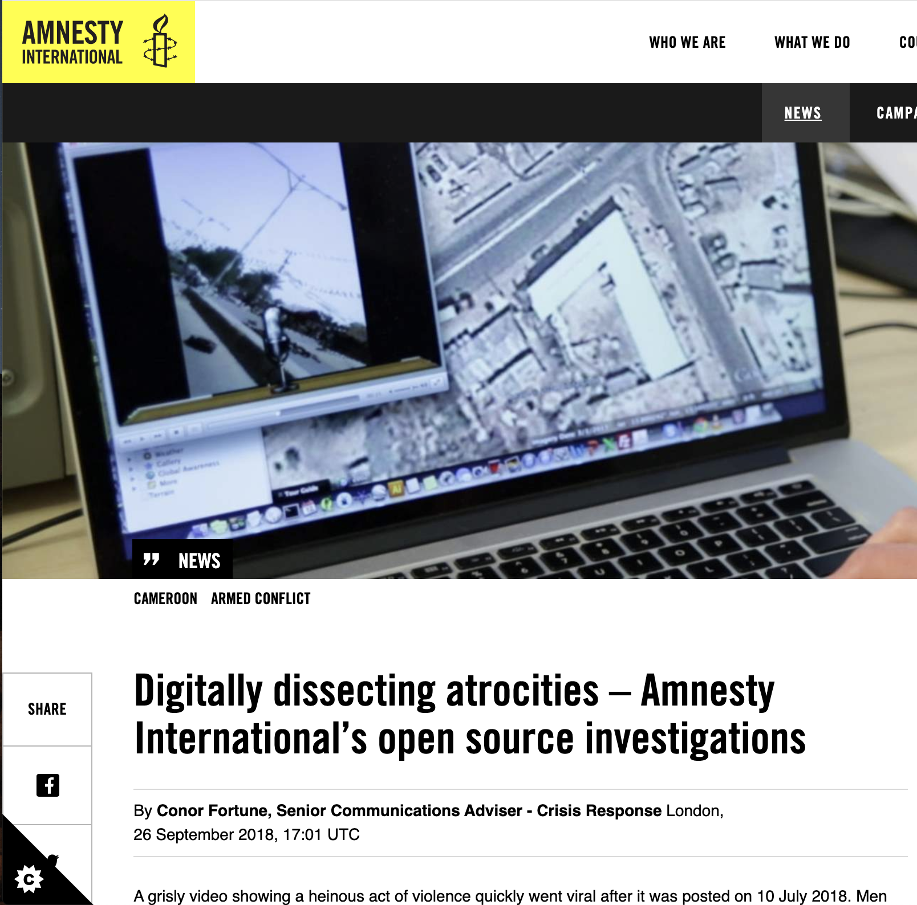
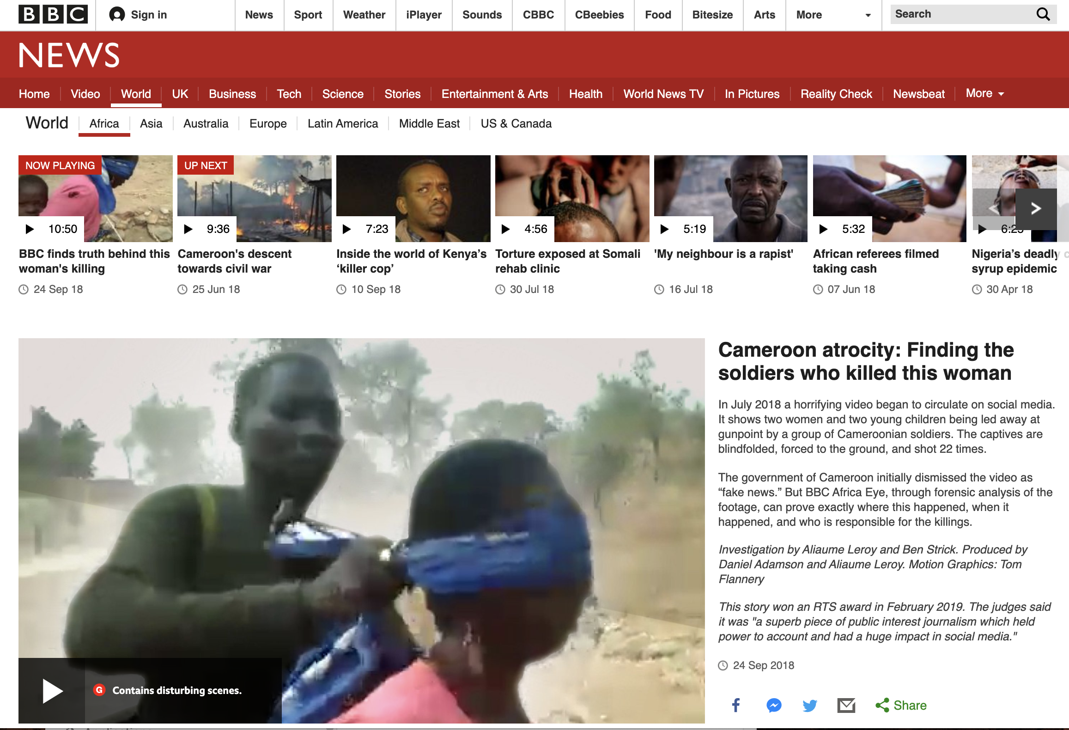
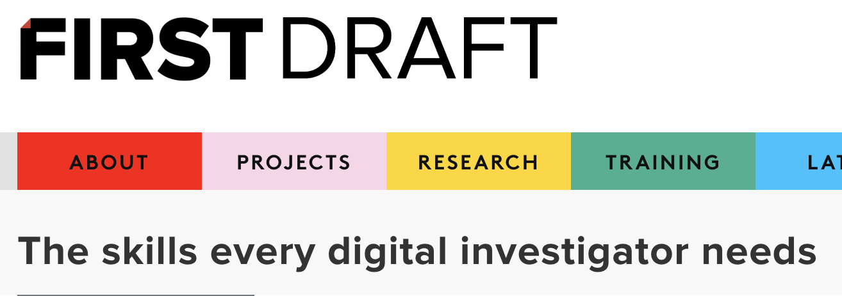

Slide 3
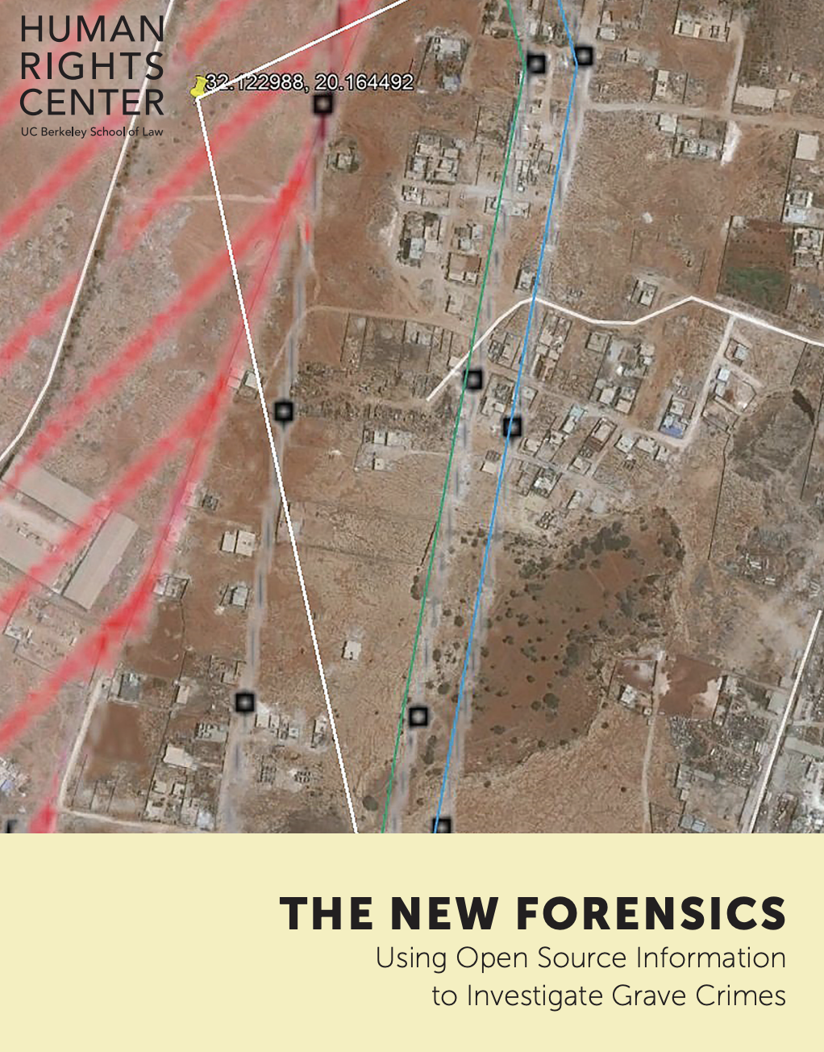
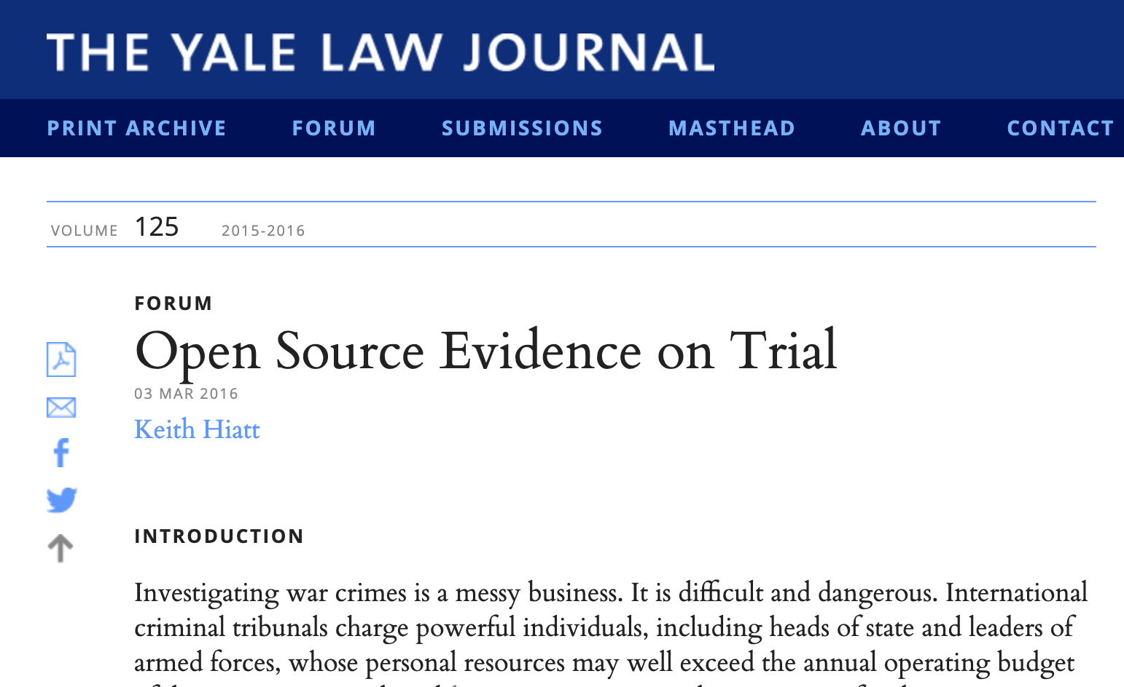
Authenticating documentation for evidentiary use

Slide 4
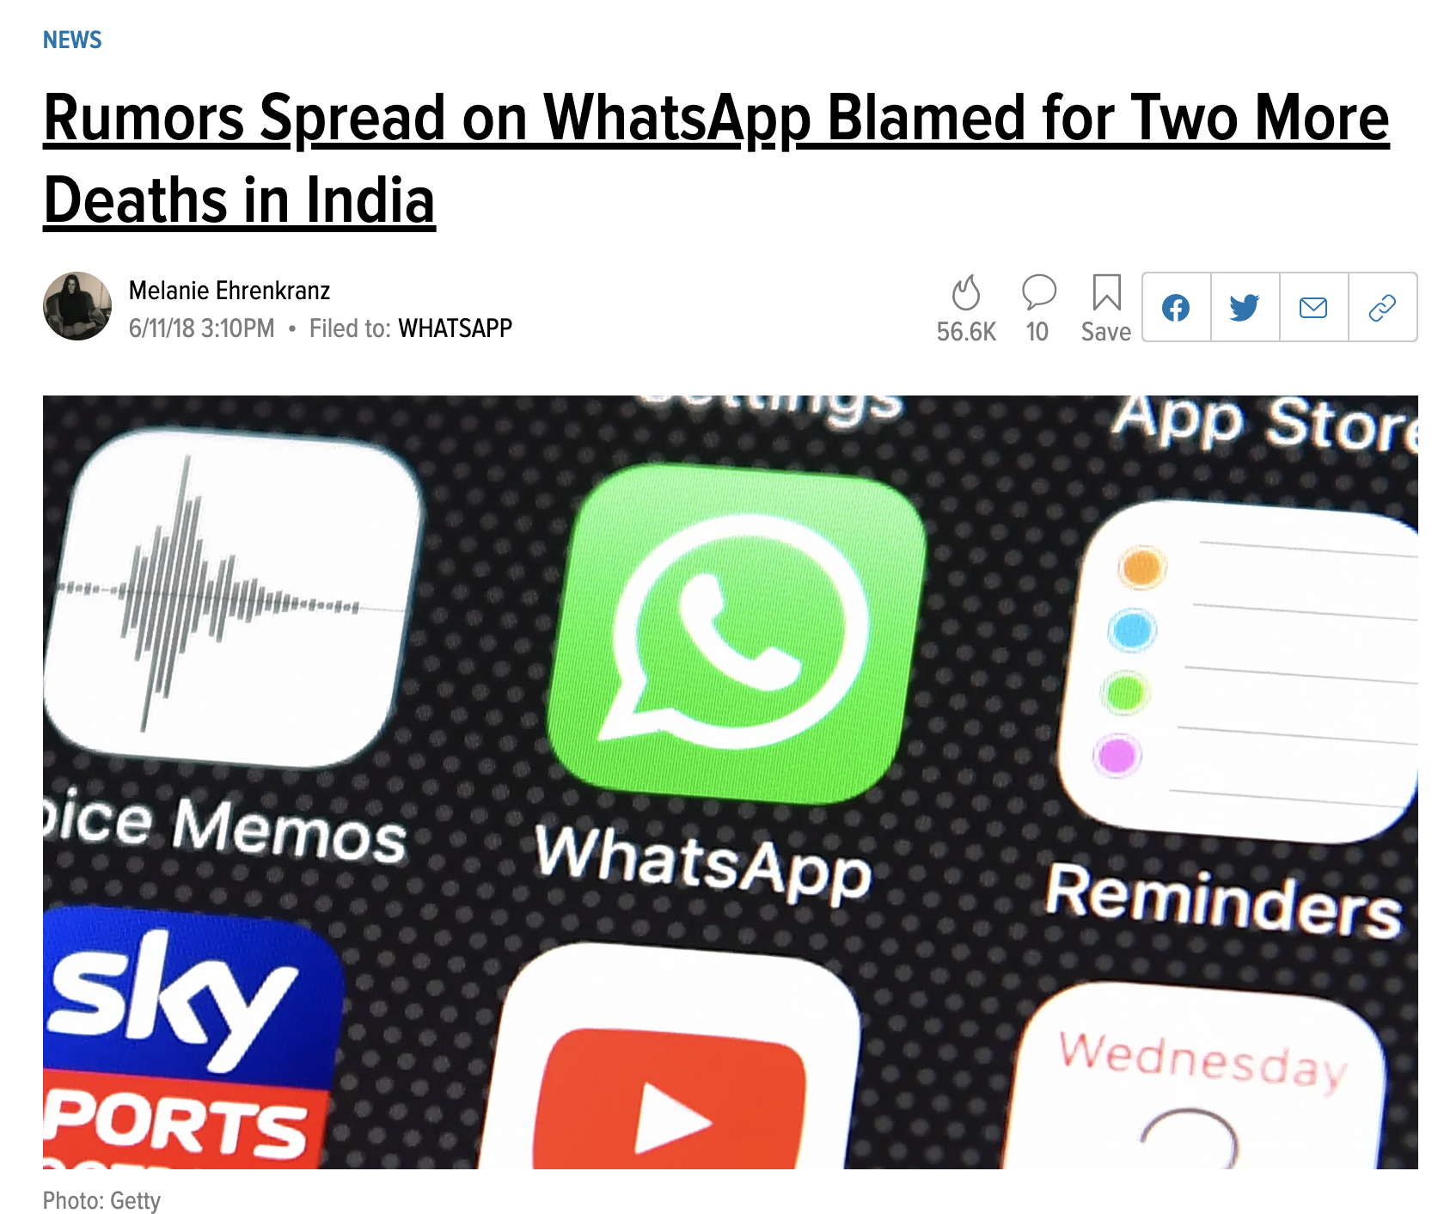
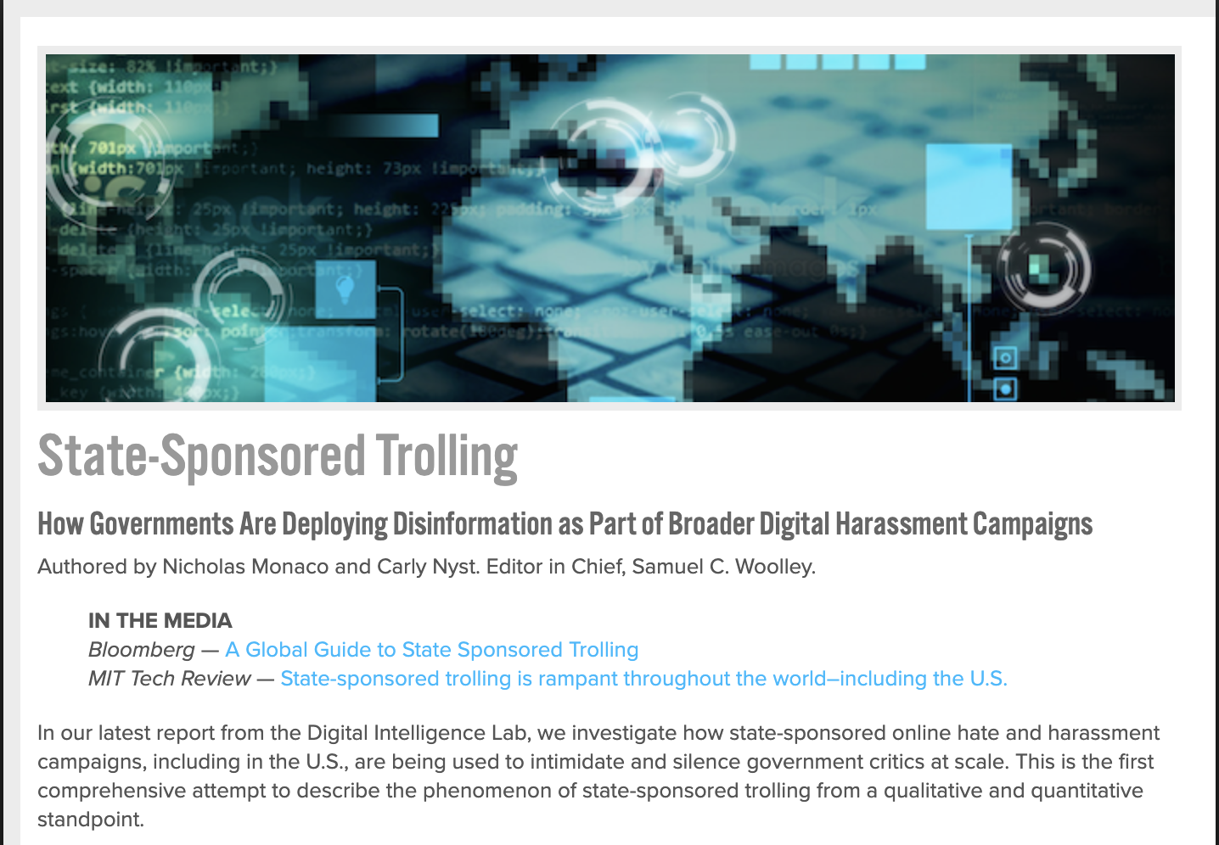
Public literacy about manipulated information

Slide 5
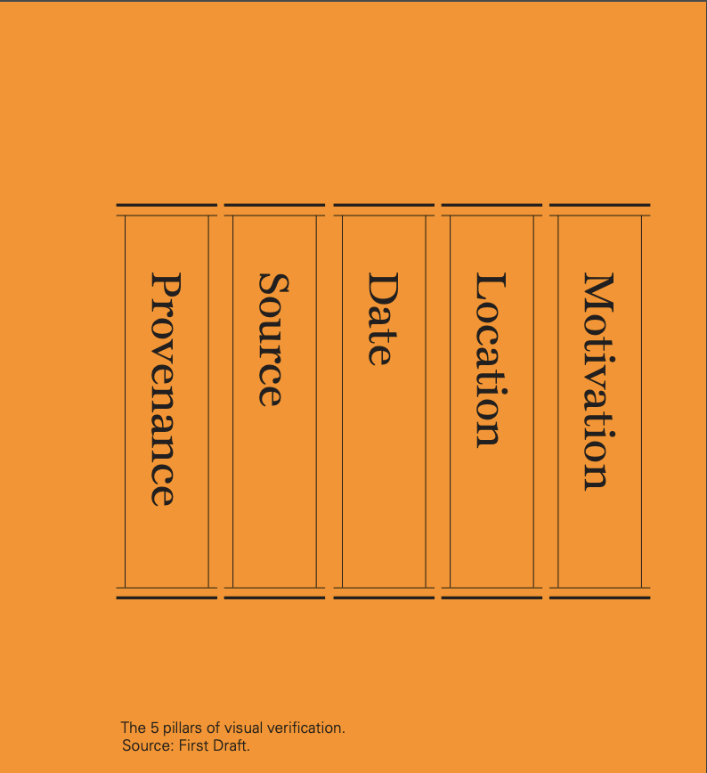

Slide 6
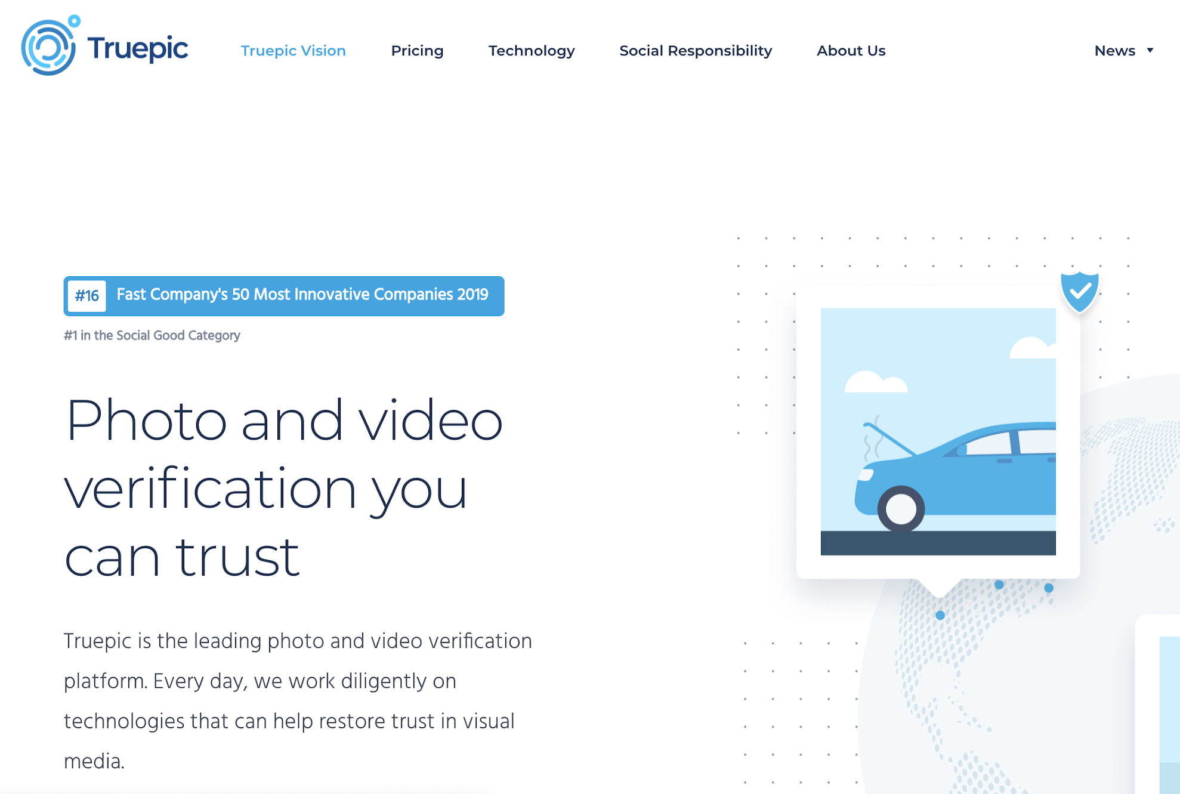
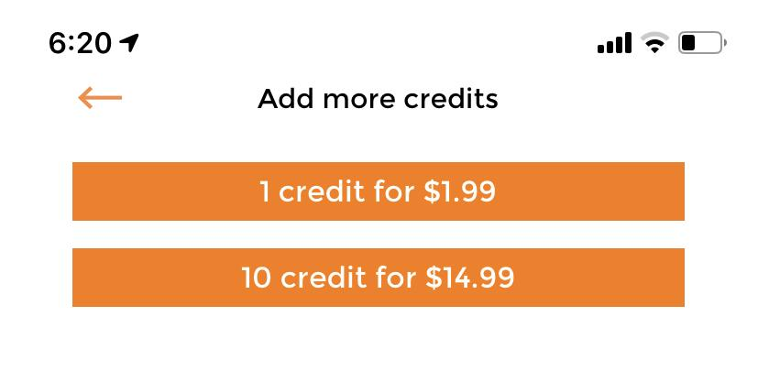
Emerging proprietary verification services

Slide 7
What can we glean about provenance, creation, and intention based on AV attribute analysis?
What computer vision / image forensic tools and techniques can be shared by open source community for authenticating and verifying media?
What knowledge can be shared to raise public literacy about media manipulation?
What role can open source community play in development of standards for trustworthy media capture and verification?

Slide 8
Open source projects
(verification via signatures / metadata, not image analysis)
?
ProofMode (by Guardian Project with WITNESS)
Tella (by Horizontal)
Others?

